Slide 1

Process Mining Virtual Internship
by
G.BALA MADHU
Roll No. 214G1A3258
Department of Computer Science and Engineering (Data Science)
Srinivasa Ramanujan Institute of Technology
(Affiliated to JNTUA & Approved by AICTE) (Accredited by NAAC with ‘A’ Grade & Accredited by NBA (EEE, ECE & CSE)
Rotarypuram Village, B K Samudram Mandal, Ananthapuramu – 515701.
2023 - 2024

Slide 2

Contents
Course Objective
Introduction
Technology
Applications
Modules
Real Time applications
Learning outcomes
GitHub Link
Queries

Slide 3
Course Objective
The primary objective of the course is to ensure that students gain a solid understanding of the fundamental concepts, principles, and methodologies of process mining.
The second main objective is to enable students to apply their acquired knowledge to real-world scenarios and datasets.

Slide 4
INTRODUCTION
WHAT IS PROCESS MINING?
Process mining is a data-driven approach that aims to discover, analyze, and improve real business processes using information extracted from event logs.
Process mining starts with process discovery, where algorithms analyze event logs to generate process models that represent the actual sequence of activities, decisions, and interactions within a process.

Slide 5
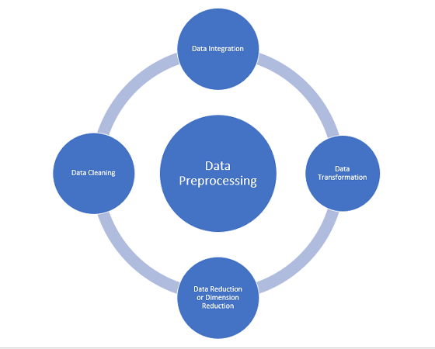
TECHNOLOGY
Data Preprocessing: Before analysis can begin, event logs often need to be cleaned and preprocessed. This might involve removing duplicates, handling missing data, and transforming raw data into a more suitable format for analysis.
Four techniques:
Data Cleaning
Data Integration
Data Transformation
Data Reduction

Slide 6
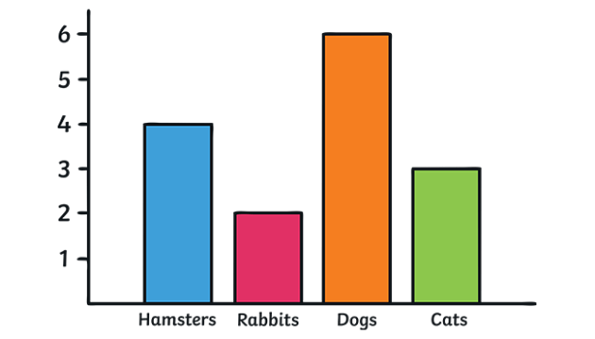
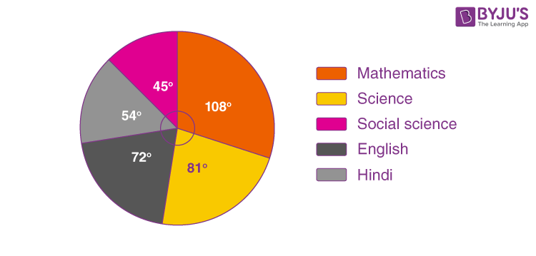
Contd..
Data Visualization: Interactive visualizations play a crucial role in process mining. They help stakeholders understand complex process behaviors, bottlenecks, and other patterns.
Examples : graphs, charts etc

Slide 7
MODULES
STEPS INVOLVED IN PROCESS MINING:
Data Collection
Data Understanding
Data Preparation
Data Modeling
Data Evaluating

Slide 8
contd..
Data collection
It involves gathering event data from various sources within an organization's information systems, databases.
Data understanding
Data understanding in process mining refers to the process of gaining a comprehensive understanding of the data that will be used for analysis.
Data preparation
It is a crucial step in the process mining workflow. It involves transforming and structuring the raw event data into a suitable format for analysis.

Slide 9
contd..
Data modeling
Data modeling in process mining refers to the creation of graphical representations or mathematical models that capture the behavior, structure, and characteristics of business processes using the event data collected.
Data evaluating
In the context of process mining, data evaluation involves assessing the quality, relevance, and appropriateness of the data before and during the analysis.

Slide 10

REAL TIME APPLICATIONS
Patient Journey Analysis: Examining electronic health records and medical device data to visualize patient treatment paths, uncover treatment variations, and enhance care coordination.
Public transportation: It generate a vast amount of data from various sources, such as ticketing systems, GPS tracking devices on vehicles, passenger counting sensors, and more.

Slide 11

contd..
Loan Application Processing:
Analyzing the loan approval process to identify areas of inefficiency and reduce the time taken for loan processing.

Slide 12
LEARNING OUTCOMES
It improve problem solving skills of students.
It is a technique used to analyze and visualize processes based on event data recorded in information systems.

Slide 13
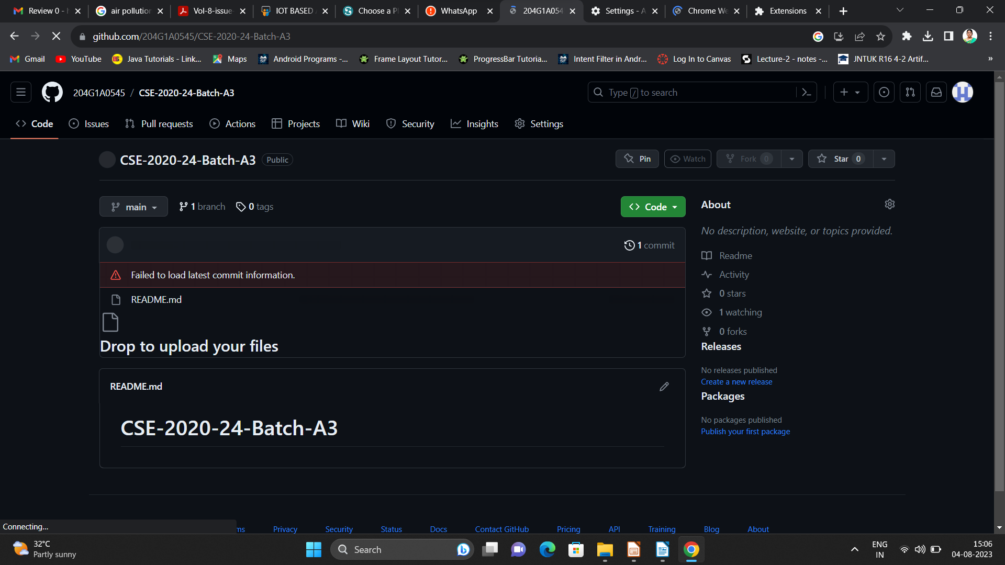
Github Dashboard
Repository Name Like: Summer Internship - I
Under that include document, presentation and Certificate(Pdf).

Slide 14
Any Queries?

Slide 15
Thank You!!!

